Slide 1
Crossing the line
Lived experience of sexual violence among trans women of colour in Australia
Notes:
Highlight that the findings presented in the workshop are based on the Crossing the Line: Lived Experiences of Sexual Violence among Trans Women of Colour in Australia.

Slide 2
OBJECTIVES
In this presentation we will:
1
Report the lived experience of sexual violence against trans women of colour, in an Australian context
2
Highlight that sexual violence is a significant issue for all women in Australia
3
Suggest solutions to address sexual violence among trans women of colour
4
Highlight the policy implications of our research findings
Notes:
Outline the objectives of the presentation.

Slide 3
Who are trans women of colour?
Transgender (“trans")
Transgender ("trans") describes a person who does not identify with their gender assigned at birth
Trans woman
A trans woman is a person who was assigned male at birth, but identifies as a woman
Trans women of colour
Trans women of colour are from a range of culturally and linguistically diverse (CALD) groups, living in predominantly white societies, such as Australia
LGBQ
Some trans people identify as lesbian, gay, bisexual or queer (LGBQ); others identify as heterosexual or straight
Cisgender
Cisgender people are those who identify as the gender assigned at birth
Notes:
Outline the different terminology used throughout the presentation. This is important particularly for audiences who may have limited experience working with gender or sexuality diverse communities.

Slide 4
What is sexual violence?
Sexual harassment
Unwanted touching, grabbing, kissing or fondling; indecent phone calls, texts, emails or posts; inappropriate comments about body or sex life; indecent exposure; receiving unwanted sexual photos
“
Sexual assault
Rape, attempted rape; aggravated sexual assault (assault with a weapon); indecent assault; penetration by objects; forced sexual activity that did not end in penetration; attempts to force a person into sexual activity
Sexual violence is everywhere. I’ve had this cloud over me that sexual violence is real and it’s happening all the time around me and it’s happening to me as well.
Fiona
Notes:
The key learning points of this slide are:
-Sexual violence is an umbrella term, covering both sexual harassment and sexual assault.
-The quote by Fiona highlights the pervasive nature of sexual violence against trans women of colour.

Slide 5
Exploring sexual violence experiences among trans women of colour
What is our evidence?
Previous research
Interviews + photovoice
31 interviews
19 photovoice participants
Online forum analysis
950 posts analysed
Online survey
trans women (n=180, 15% CALD)
cisgender heterosexual women (n=1249, 8% CALD)
cisgender LBQ (n=866, 13% CALD)
Notes:
This slide outlines the types of data that will be drawn on through the presentation.

Slide 6
Who is at risk of sexual violence in adulthood?
Previous research
More at risk
Higher rates
Trans people of colour³
Trans women⁵
Trans people²
Lesbian & bisexual women⁴
Women¹
White trans people
LGBTQ
groups
Cis- gender people
Hetero- sexual women
Men
Less at risk
Lower rates
1. Callander et al 2019; Stozer, 2009 2.. Callander et al 2019; Stozer, 2009 3. James et al., 2016 4. Callander et al., 2019; Centers for Disease Control and Prevention, 2010; Drabble, 2013; Stozer, 2009 5. National Coalition of Anti-Violence Programs 2014, 2015, 2016
Notes:
The key learning point of this slide is:
-Trans women of colour are multiply marginalised, putting them at very high risk of experiencing sexual violence.

Slide 7
TRANS WOMEN OF COLOUR ARE AT HIGH RISK OF SEXUAL VIOLENCE
Intersecting identities
Ethnicity
Women of colour
Gender
Trans, and a woman
Sexuality
LGBQ
Social class
Lower SES; migration impact
Notes:
This slide is a graphic representation of slide 6. It highlights that trans women of colour who are sexuality diverse and a migrant or of lower socio-economic status may face multiple forms of marginalisation (e.g transphobia, sexism, racism, homophobia) that put them at high risk of sexual violence.

Slide 8
How do trans women of colour understand sexual violence?
Sexual harassment
Unwanted touching, grabbing, kissing or fondling; indecent phone calls, texts, emails or posts; inappropriate comments about body or sex life; indecent exposure; receiving unwanted sexual photos Transphobic abuse: misgendering, "catcalling", hostile looks + staring, fetishisation
Sexual Assault
Rape, attempted rape; aggravated sexual assault (assault with a weapon); indecent assault; penetration by objects; forced sexual activity that did not end in penetration; attempts to force a person into sexual activity
Notes:
The key learning points of this slide are:
-This slide repeats slide 3, but also includes the definitions of sexual harassment that were given by trans women of colour in the study.
-This finding highlights the importance of asking participants what they consider to be acts of sexual violence, as formal definitions may not be all inclusive to marginalised populations.

Slide 9
Gender transitioning and sexual violence
There is increased risk of social exclusion and sexual violence during and after transitioning.
social ISOLATION
rejection
from family, LBGQ + religious communities
social acceptance
FINDING “TRUE SELF”
My mother just kicked me out of the house ʼcause I told her I was trans.
Asami
Notes:
The key learning point to this slide is:
-Gender affirmation is a journey, often starting early in life. While it is a positive process for most trans women, it is also accompanied by a number of negative factors, such as isolation, rejection and increased risk of violence.

Slide 10
Positive consequences of gender transitioning
It’s literally, I was at a place where I feel at home in my body and non-traumatised.
Lin
Notes:
Using participant’s photos and associated accounts, the following slides highlight the positive aspects of gender affirmation explored by women in this study.

Slide 11
Feeling feminine, feeling like a woman.
White roses represent new beginnings, new life. I feel like I have a new life now, I’m a woman now, and, you know, I’m a different person than who I used to be. I’m much more authentic. I’m much more real.
Gabriella
Notes:
Using participant’s photos and associated accounts, the following slides highlight the positive aspects of gender affirmation explored by women in this study.

Slide 12
Migration provided opportunity for gender affirmation
I went to the airport and I changed out of my guy clothes and that was that, that was the start of my true life pretty much, and ever since then I’ve been happy and I haven’t stopped feeling happy.
Emma
Notes:
The key learning points of this slide are:
-This slide demonstrates how migration to Australia provides greater opportunity for gender affirmation among trans women of colour, who are from CALD backgrounds.
-This was particularly the case for women who were migrating from contexts where being trans was illegal.

Slide 13
Pressure to “pass” to avoid sexual violence
“Transwomen are incentivized to embody heteronormative femininity and comply with heterosexual practices. If they do not, they may encounter violence or harassment.”
(Yavorsky & Sayer, 2013, p. 514)
“
I specifically remember how I felt that day. I was dressed, and I went to the theatre to see a musical. And while I was at a theatre, like I had all these men telling me that I looked beautiful, and I looked amazing. So on a day like that day I just felt like the prettiest girl in the world.
Gabriella
Notes:
The key learning point of this slide is:
-As found with previous research, trans women of colour in this study, felt pressure to pass as a woman in order to avoid sexual violence.

Slide 14
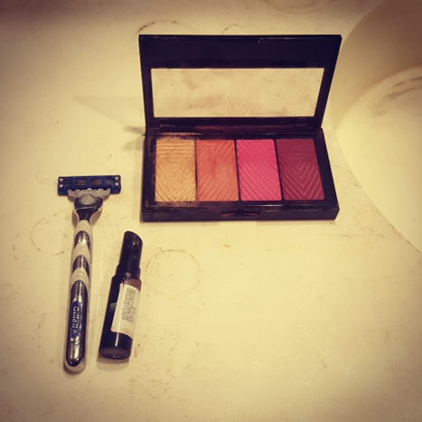
Being a woman = fear and risk of violence
My biggest shock came not from being the target of transphobia, but misogyny.
Online Forum-010
Embodying modifications that leads to certain kinds of gender outcomes and differing degrees of vulnerability.
Lin
Notes:
The key learning point of this slide is:
-While trans women of colour may avoid transphobic violence through passing, they become subject to sexual violence by men because they are a woman.

Slide 15
Being a trans woman = fear and risk of violence
It was a car that drove past me in the opposite direction … It was just a guy who gave a generic "woo". I don’t know if it was because I was a woman or a trans woman who doesn’t pass.
Lisa
Notes:
The key learning points of this slide are:
-At times women are not certain whether sexual violence is perpetuated against them on the basis of being trans, or because they are a woman.
-Trans women of colour are at risk of sexual violence due to men’s perception that they are deserving of violence, because trans women have ‘tricked’ them to believe they are a woman - this causes significant fear among trans women of colour.

Slide 16
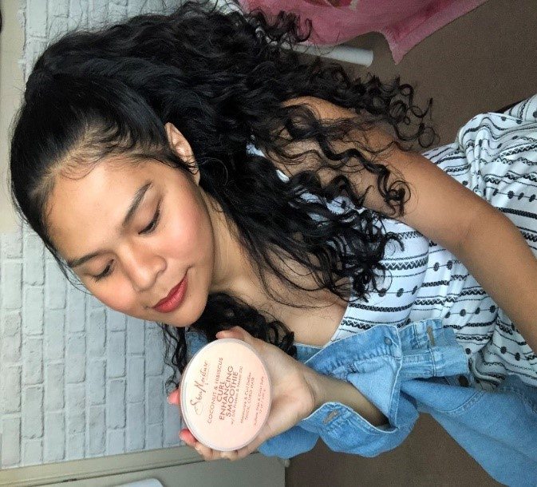
White femininity and struggles to pass
As a trans woman of colour, I have brown skin, everyone literally in the trans community is, like, you have to lighten up your skin for you to be prettier, for you to be more passable, for you to be more feminine.
Jennifer
Notes:
The key learning points of this slide are:
-Women felt as though they had to live up to White feminine standards of beauty.
-Some women were not concerned about passing, and others did not want to pass, or explored their gender in different forms.

Slide 17
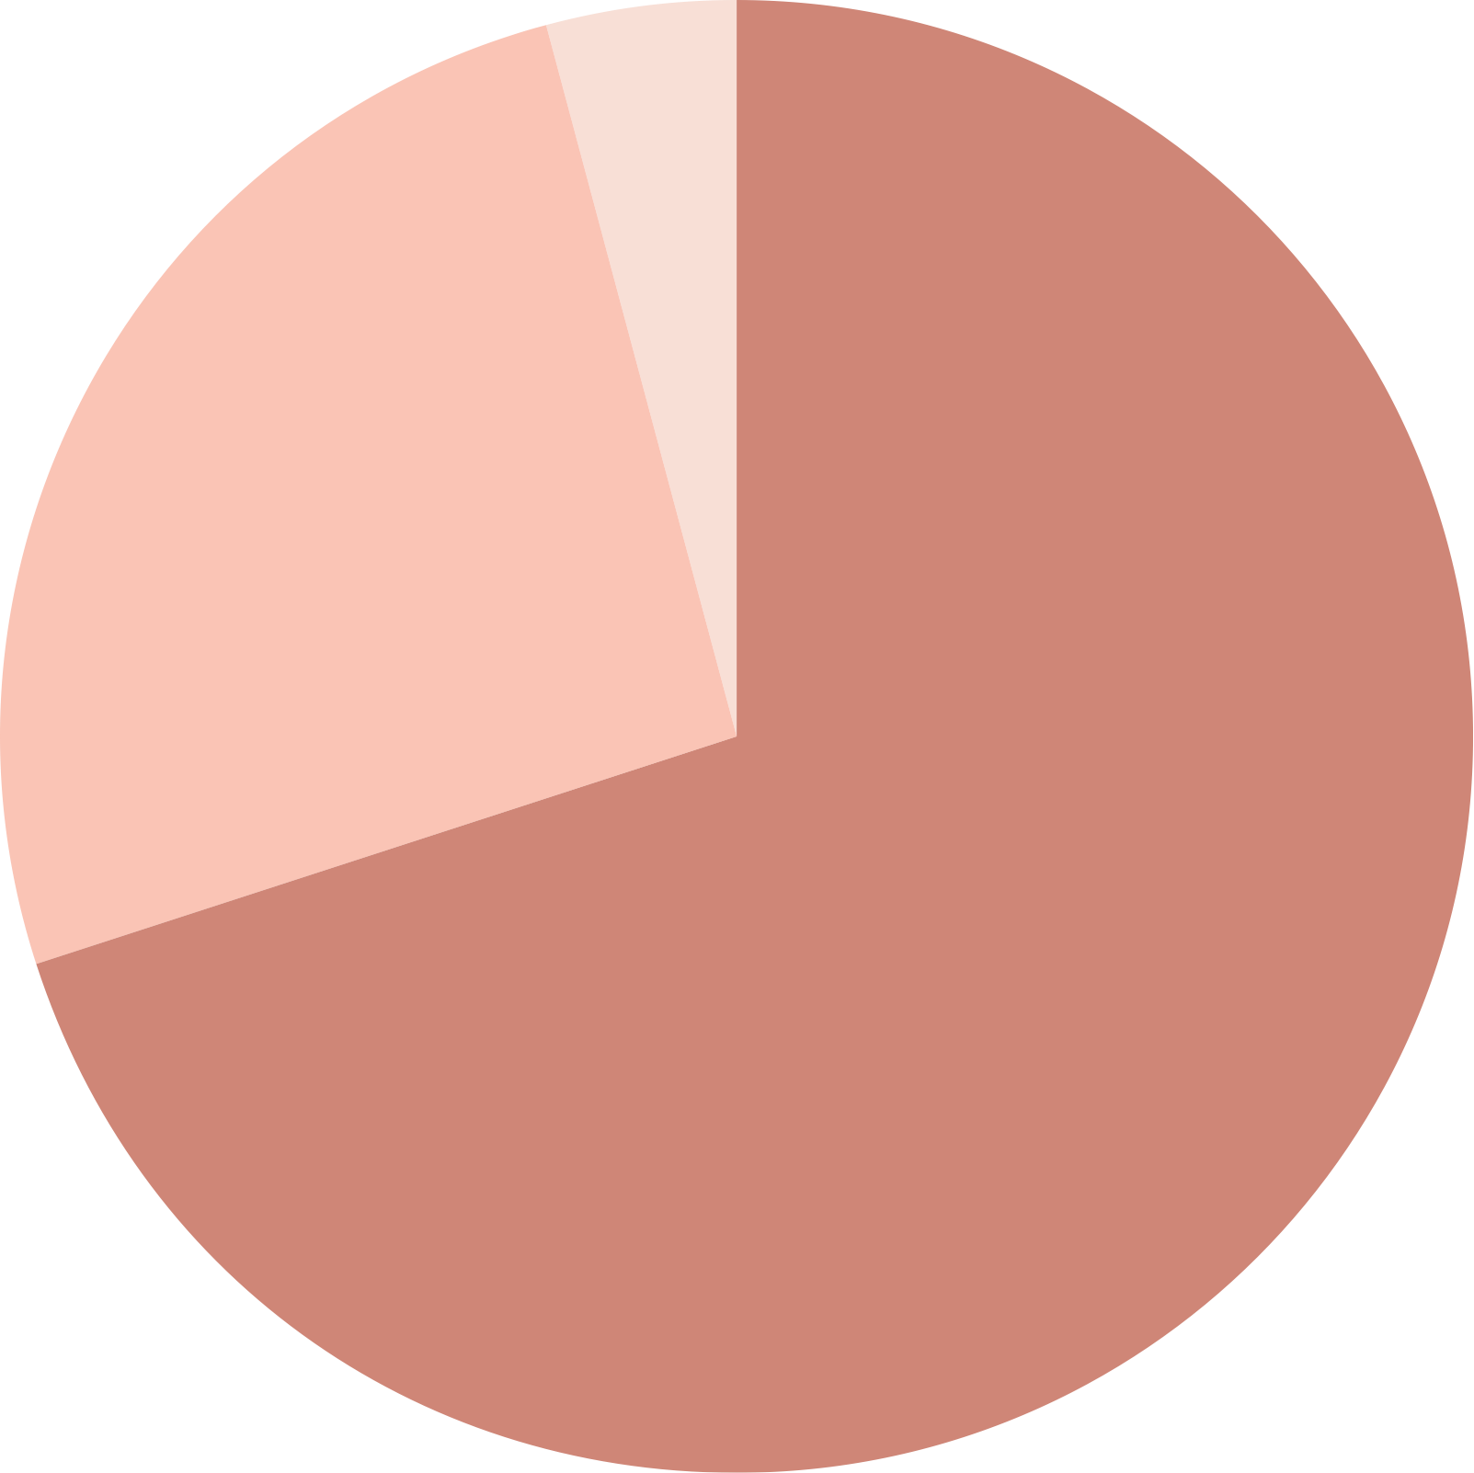
Intersecting identities
CALD trans women reported more frequent sexual harassment
than other women
6%
Trans women– non-CALD; cisgender
The intersection of gender, cultural identity, and sexual identity intensifies harassment
Misgendered, transphobic comments, mockery, insult
Outed as trans or as a man—could lead to social exclusion, or danger
Verbal abuse when using women’s public toilets; called “predators” or “perverts”
Once
4%
40%
Trans women– non-CALD;
56% cisgender
2–10 times
26%
54%
Trans women– non-CALD;
40% cisgender
10 or more times
70%
Notes:
The key learning points of this slide are:
-Using data from the survey, this slide highlights that while sexual harassment is experienced by all women, CALD trans women reported more frequent sexual harassment than other women.
-Rates in the central circle are for CALD trans women; outer circles are for non-CALD trans women and cisgender women

Slide 18
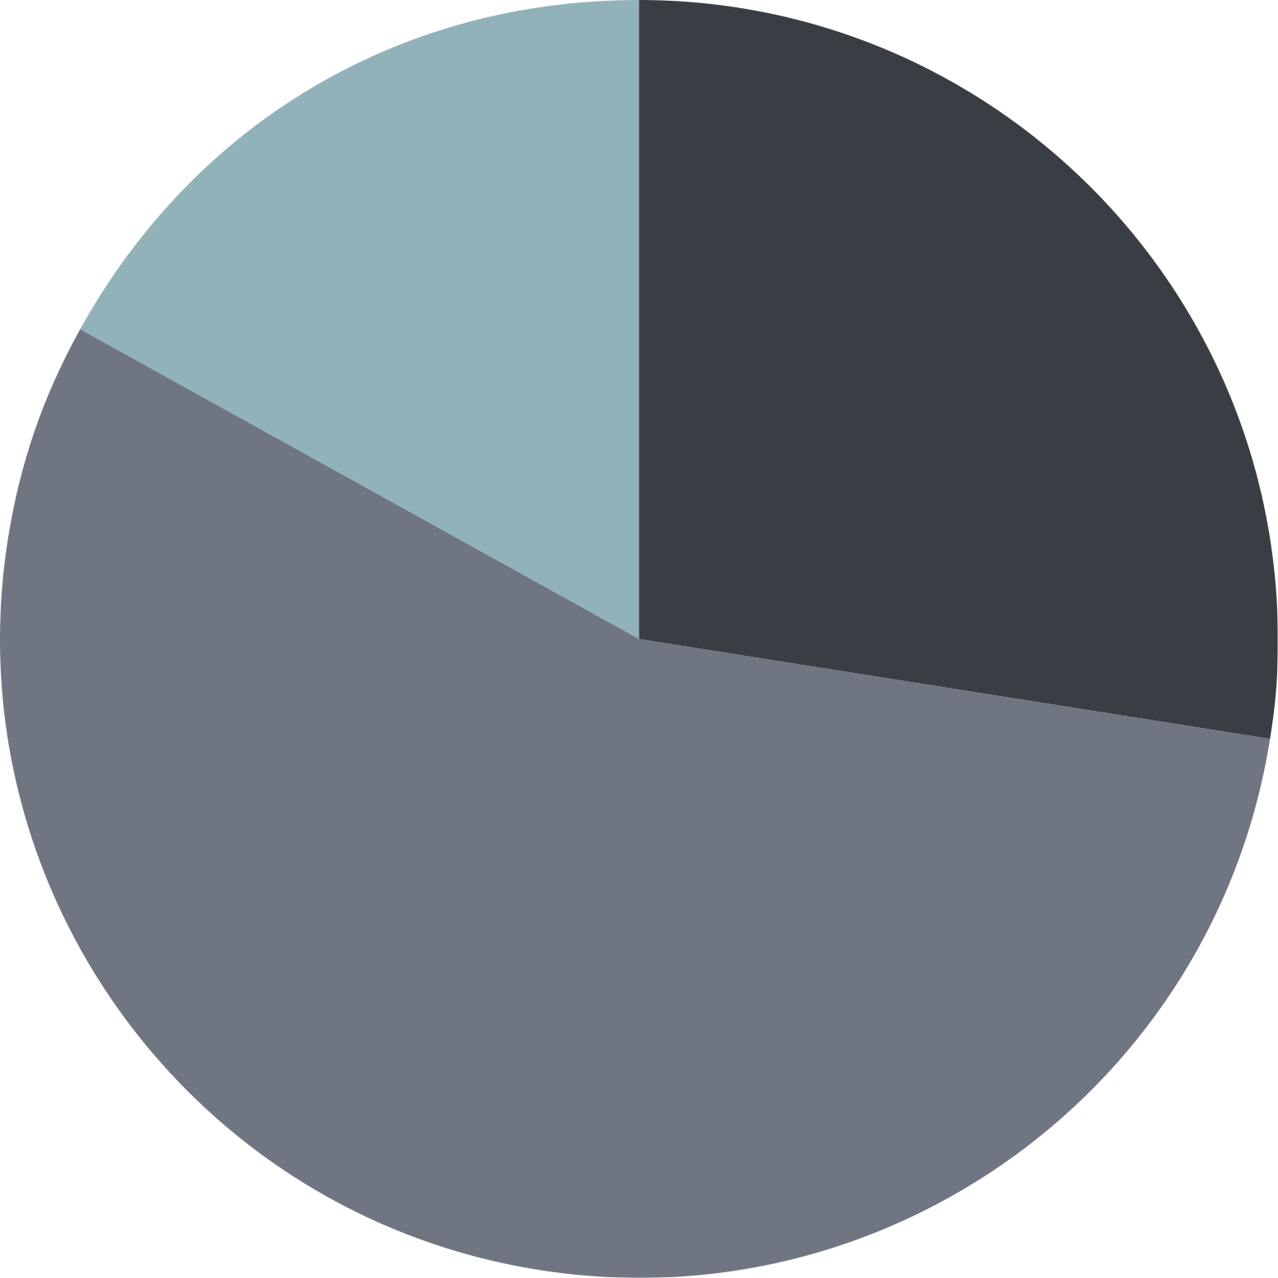
Intersecting identities
CALD trans women more likely to report having been
sexually assaulted 10 or more times
12%
Trans women– non-CALD; 16% cisgender
27%
Trans women– non-CALD and cisgender women
Assault ranged from groping or unwanted touch—commonly in clubs or on public transport—to forced sexual acts and rape
The sexual assault was often accompanied by physical assault—primarily by groups of cisgender men
Once
17%
10 or more times
28%
2-10 times
56%
61%
Trans women– non-CALD;
58% cisgender
Notes:
The key learning points of this slide are:
-Using data from the survey, this slide highlights that CALD transwomen are more likely to experience more frequent sexual assault than other women.
-Rates in the central circle are for CALD trans women; outer circles are for non-CALD trans women and cisgender women

Slide 19
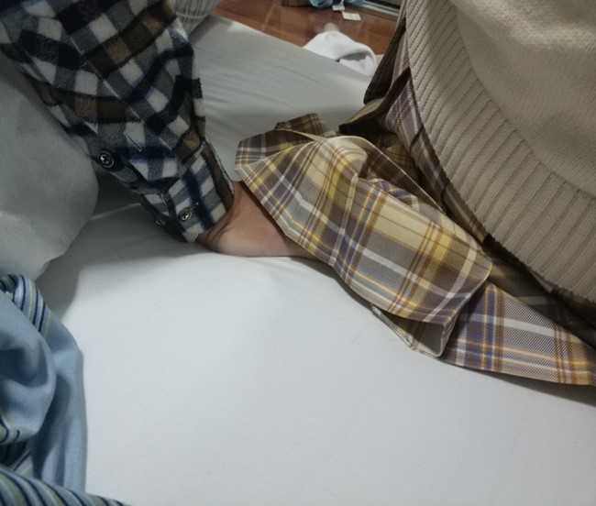
Sometimes, a man, sometimes they will actually touch the, the woman’s part.
Mei
That’s actually a photo of the train, where I was physically harassed. I was harassed multiple times on public transportation.
Jennifer
Notes:
The key learning points of this slide are:
-Trans women of colour experience multiple forms of verbal sexual harassment.
-Women also experienced being outed in public, which they felt put them at higher risk of sexual violence.
-Sexual harassment frequently happened in night clubs and public transport.

Slide 20
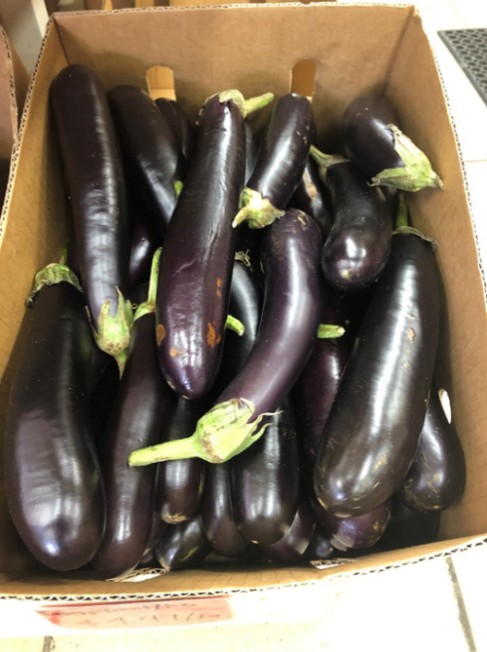
Sexual violence and fetishisation
Dating and new relationships brought a heightened risk of physical and sexual violence
Physical and sexual assault from clients during sex work: transphobia and racism, reduces safe spaces to practice sex work
Physical sexual assault reflects the fetishisation of trans women of colour—served to legitimate objectification and sexual violence
Women experienced invasive questioning about and touching of genitals
This is also one meaning of sexual violence for me, is to be objectified, like, eggplants … if guys see trans women they already have assumptions about what we are, and what we can do. So, we’re, like, being turned into something we’re not.
Jennifer
Notes:
The key learning point of this slide is:
-Women frequently discussed being fetishized, including having their genitals asked about or touched.

Slide 21
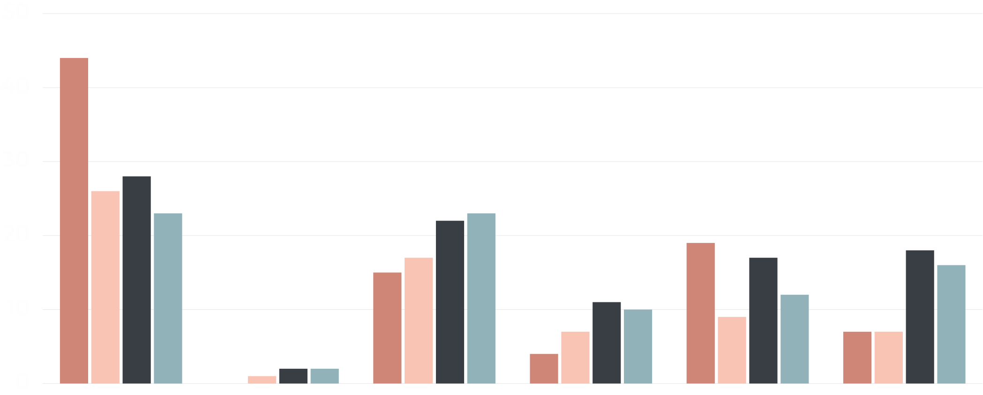
Perpetrators of sexual assault
CALD trans women—highest rate of sexual assault by a stranger
%
STRANGER
CURRENT PARTNER
PREVIOUS PARTNER
BOY/GIRL-FRIEND OR DATE
EX BOY/GIRL-FRIEND OR DATE
OTHER KNOWN PERSON
Trans women– CALD
Trans women– non-CALD
Cisgender– LBG
Cisgender– hetero
Notes:
The key learning point of this slide is:
-For CALD trans women, the perpetrators of sexual violence are much more likely to be strangers.

Slide 22
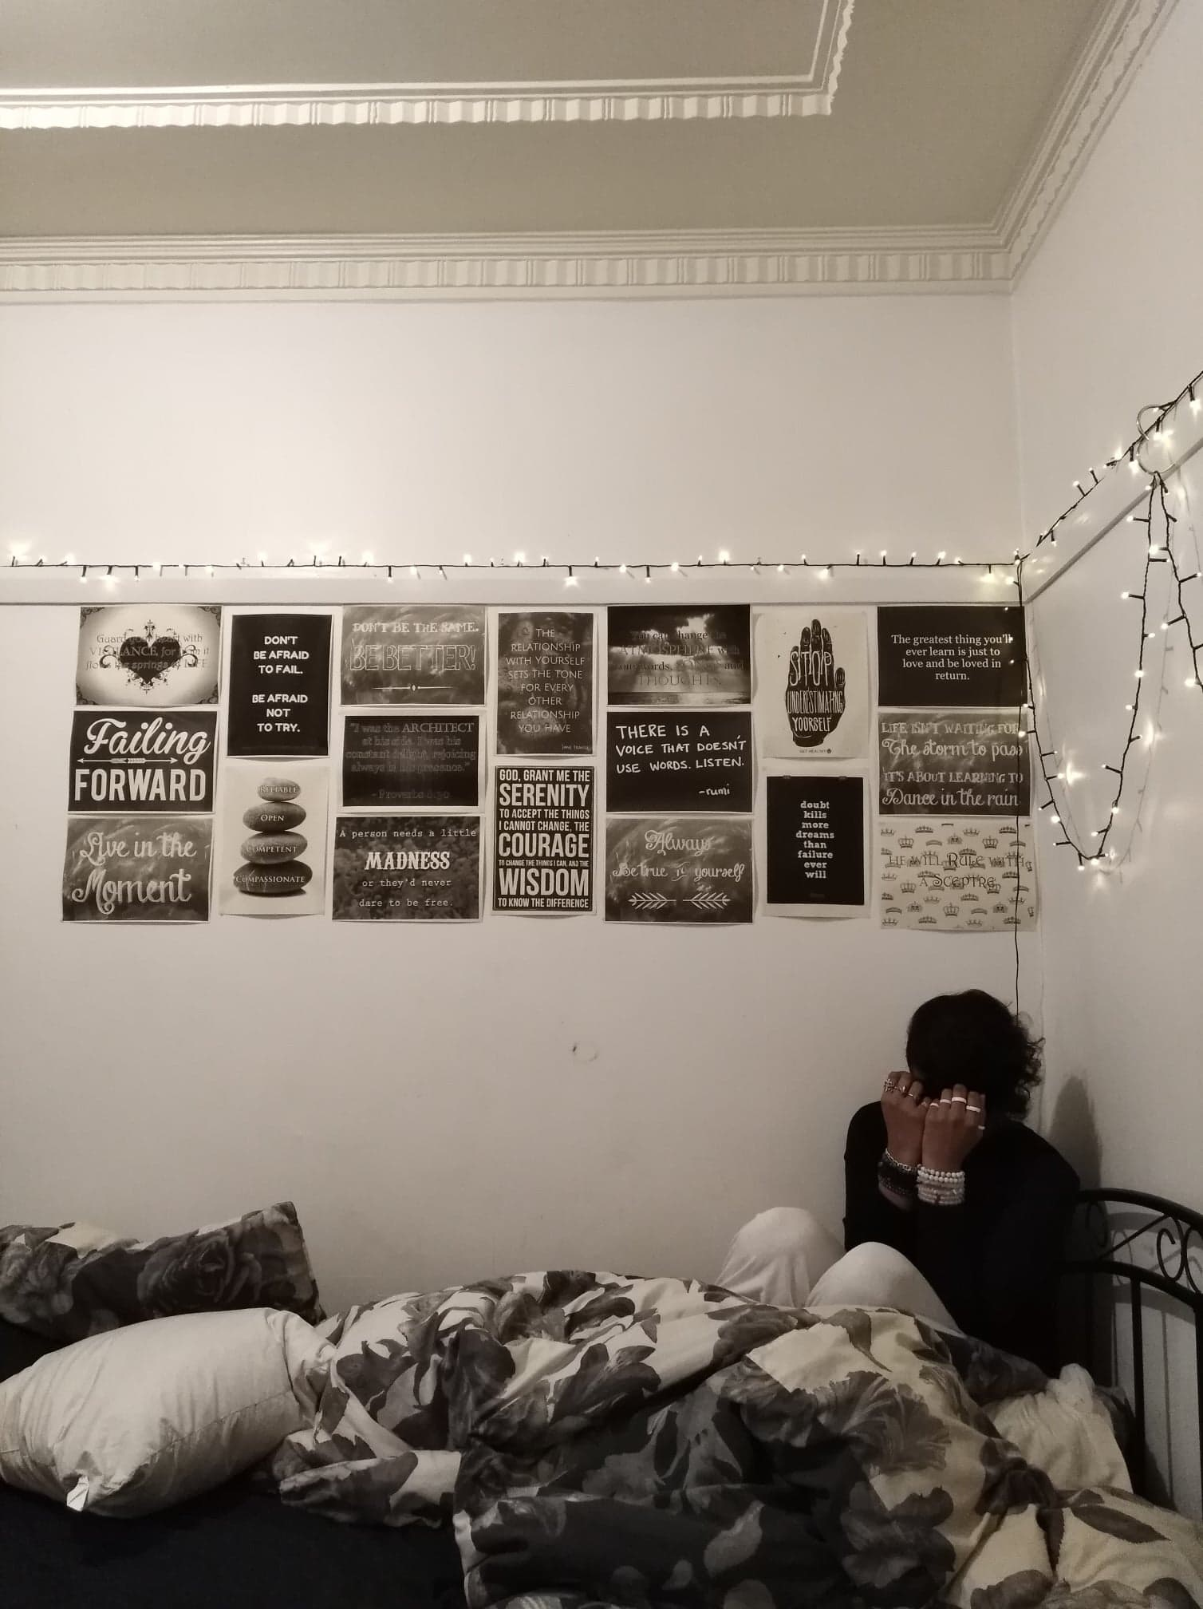
Impacts of sexual violence
Hypervigilance and self-isolation
I have learnt to move around the world as a minority person and now as a woman, keeping myself small and quiet and so on, that’s the way I avoid [sexual violence] as much as possible.
Elizabeth
Fear and distress
Constant fear of further sexual violence
Negative psychological consequences: anxiety, depression, suicidal thoughts, self-blame, normalisation of sexual violence and vicarious trauma
Notes:
The key learning point of this slide is:
-Sexual violence have long term negative implications on the mental health and wellbeing of trans women of colour.

Slide 23
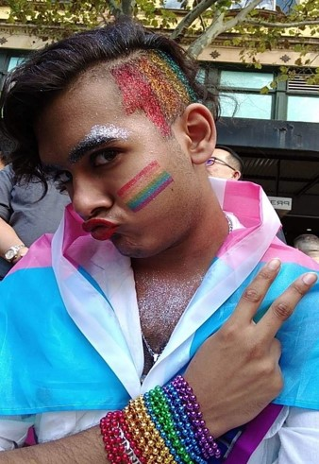
Behavioural responses to sexual violence
Resilience | Pride | Freedom
Labelling and reporting sexual violence, rejecting self-blame, talking about experiences of violence and prioritising self-healing
Even though I look hella different, I can still pose the same way as you, I can still act same way as you, I can still talk the same way as you, I'm still human. We exist, we deserve attention, we deserve to be recognised and we deserve to be appreciated, as part of the human species, part of our cultural, our humanity, our sexuality.
Sam
Notes:
The key learning points of this slide are:
-While trans women of colour experience multiple forms of marginalisation resulting in exposure to sexual violence, they also adopt a number of strategies to counter their negative experiences.
-These include: Reporting sexual violence, rejecting self-blame, self-pride and talking about experiences of sexual violence are examples of women’s resistance and resilience in the face of marginalisation.

Slide 24
Self-support is the primary mode of coping for all women
Support is central to resilience
Support sought from friends, family, the transgender community, GPs, clinic nurses, and psychologists facilitated coping and resilience
Trans women–CALD
70% myself (self-support)
30% other support
Trans women–non-CALD
55% myself (self-support)
45% other support
Cisgender–LBQ
70% myself (self-support)
30% other support
Having a whole army of trans girls behind you, who have had a similar journey as you…makes it easy for you to vent
Gabriella
Cisgender–hetero
65% myself (self-support)
35% other support
‘“Other support” includes family, friends, partner, community, medical, psychological, police/justice and no support
Notes:
The key learning point of this slide is:
-Using data from the survey, this slide highlights that for all women, self-support is most commonly adopted following an experience of sexual violence.

Slide 25
Absence of support
Psychological distress and isolation
Formal support available to cisgender women often not accessible or adequate for trans women
Negative experiences with police/legal system–judgement, blame, mistrust, a lack of DNA testing, some experiences of physical violence and sexual harassment
When I was sexually assaulted, I had very bad support and I’ve been in knots ever since. And even though more recently, I’ve managed to access support, I still feel like I’m tied in knots and my emotions are very complicated.
Fiona
Notes:
The key learning points of this slide are:
-Trans women of colour at times experience transphobic or non-inclusive care from healthcare professionals impacting on their willingness to access support.
-In addition, support networks, such as support groups do not address specific issues faced by trans women of colour or do not allow for trans women to participate.
-When seeking legal support, particularly police, for experiences of sexual violence, trans women of colour often experience extreme forms of stigmatisation, blame and inadequate care. This makes women reticent to access support, and sexual violence frequently goes unreported.

Slide 26
What do women want?
Trans women’s solutions to sexual violence
Education for the public, healthcare professionals and police
Legal redress, inclusion and empowerment including voice in legislation, policy and practice
Access to hormones for gender affirmation and decriminalisation of sex work
Notes:
This slide outlines specific requests from participants to address sexual violence against trans women of colour.

Slide 27
IMPlicationS for policy change
In addition to existing strategies to address sexual violence against women:
Provide education/training about gender transitioning and experiences of sexual violence among trans women of colour
Use language that is inclusive of gender and sexuality diversity
Establish greater support from the justice system for trans women of colour who have experienced sexual violence
Recognise the vulnerability and needs of trans women who are sex workers when addressing sexual violence; decriminalise sex work
Notes:
This slide outlines specific policy recommendations to address sexual violence against trans women of colour.

Slide 28
IMPlicationS for practice and services
Sexual violence prevention and support services
Make information about services accessible, visible, inclusive and sensitive to the needs of trans women of colour
Ensure support and prevention programs are be co-designed by multicultural women’s services and LGBTQ services, as well as women leaders from CALD and queer communities.
Migrant services
Make services accessible, visible and inclusive to trans women and those who are sexuality diverse
Healthcare and general practitioners
Incorporate trans affirmative care: correct pronouns, non-gendered bathrooms, and trans- and gender diverse-specific literature and health resources
Support gender transitioning to reduce the risk of transphobic violence
Notes:
This slide outlines specific practice and service recommendations to address sexual violence against trans women of colour.

Slide 29
acknowledgements
Training resource
This training resource was developed by Alex Hawkey, Jane M. Ussher and Janette Perz, and designed by Eleanor Shepherd, on behalf of the Crossing the Line Study Team. It is based on the project report (add link to report here)
Project report:
Ussher, J. M., Hawkey, A., Perz, J., Liamputtong, P., Marjadi, B., Schmied, V., … Brook, E. (2020). Crossing the line: Lived experience of sexual violence among trans women of colour from culturally and linguistically diverse (CALD) backgrounds in Australia (Research report, 14/2020). Sydney: ANROWS.
The authors would like to thank Australia’s National Research Organisation for Women’s Safety (ANROWS) for funding this research. The views expressed in this document are those of the authors and cannot be attributed to ANROWS.
Notes:
Project team acknowledgment.

Slide 30
References
Callander, D., Wiggins, J., Rosenberg, S., Cornelisse, V. J., Duck-Chong, E., Holt, M., . . . Cook, T. (2019). The 2018 Australian Trans and Gender Diverse Sexual Health Survey: Report of Findings. Retrieved from https://kirby.unsw.edu.au/sites/default/files/kirby/report/ATGD-Sexual-Health-Survey-Report_2018.pdf
Centers for Disease Control and Prevention. (2010). NISVS: An Overview of 2010 Findings on Victimization by Sexual Orientation. Retrieved from: https://www.cdc.gov/violenceprevention/pdf/cdc_nisvs_victimization_final-a.pdf
Drabble, L., Trocki, K. F., Hughes, T. L., Korcha, R. A., & Lown, A. E. . (2013). Sexual orientation differences in the relationship between victimization and hazardous drinking among women in the National Alcohol Survey. Psychology of Addictive Behaviors, 27(3), 639–648.
James, S. E., Herman, J. L., Rankin, S., Keisling, M., Mottet, L., & Anafi, M. (2016). The Report of the 2015 US Transgender Survey. Retrieved from http://www.ustranssurvey.org/
National Coalition of Anti-Violence Programs. (2016). Lesbian, Gay, Bisexual, Transgender, Queer, and HIV-Affected Hate Violence in 2016. Retrieved from https://avp.org/wp-content/uploads/2017/06/NCAVP_2016HateViolence_REPORT.pdf
Schilt, K., & Lagos, D. (2017). The development of transgender studies in sociology. Annual Review of Sociology, 43(1), 425–443. https://doi.org/10.1146/annurev-soc-060116-053348
Stotzer, R. L. (2009). Violence against transgender people: A review of United States data. Aggression and Violent Behavior, 14(3), 170–179. https://doi.org/10.1016/j.avb.2009.01.006
Yavorsky, J. E., & Sayer, L. (2013). "Doing fear": The influence of hetero-femininity on (trans) women's fears of victimization. The Sociological Quarterly, 54(4), 511–533. https://doi.org/10.1111/tsq.12038
Notes:
References used in the presentation and further reading.

